Slide 1
Sweetening Your Threat Intelligence with Automated Honeypots
Alexander Merck & Chris Collins

Slide 2
Alexander Merck
Eight years experience working in Higher Ed. security
Focus on development and automation of security processes
Chris Collins
10 years Linux sysadmin experience
Container and Automation evangelist
InfoSec Newbie

Slide 3
STINGAR

Slide 4
How do we do this?

Slide 5
Honeypots

Slide 6
STINGAR? MHN? CHN?
STINGAR (Shared Threat Intelligence for Network Gatekeeping with Automated Response) – overarching threat intelligence sharing project
MHN (Modern Honey Network) – Honeypot management and deployment system developed by Threatstream
CHN (Community Honey Network) – Forked and divergent repositories from Threatstream’s MHN project

Slide 7
Honeypot Statistics
25 honeypots deployed
  21 inside our network
  4 outside our network
~1750 events per hour
~800 IP addresses blocked a day
Primary activity is SSH bruteforcing / abuse

Slide 8
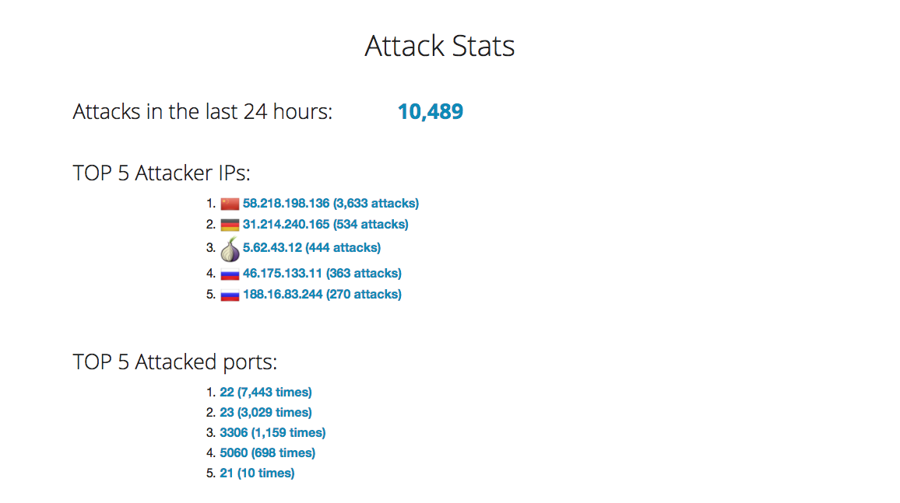

Slide 9
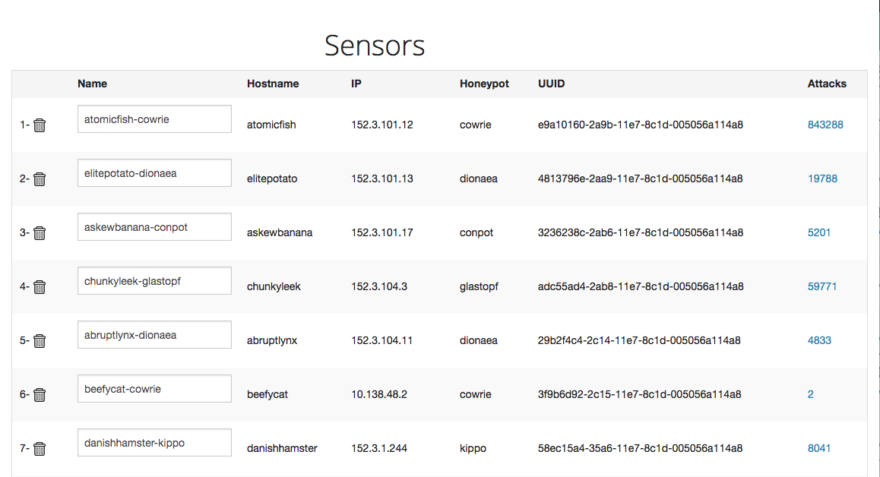

Slide 10
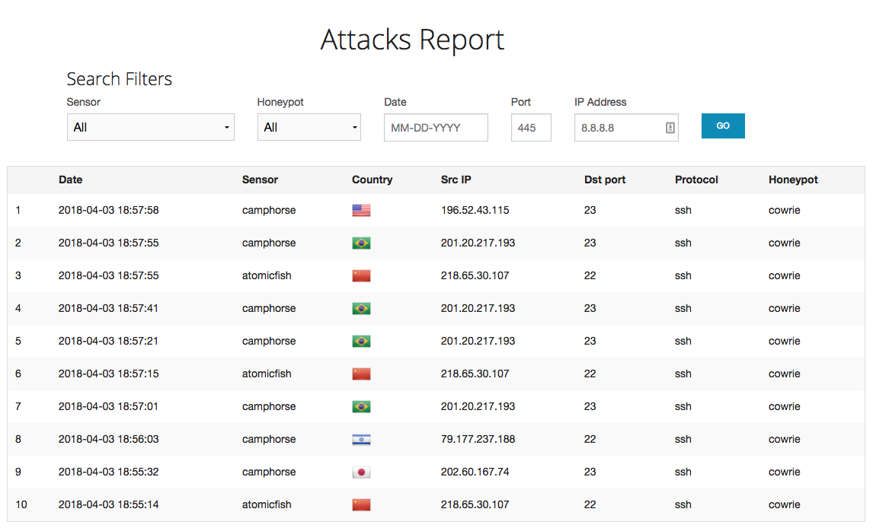

Slide 11
Why not just run MHN?
Because containers and automation are fun!
Also…
  MHN appears to no longer be actively supported by Threatstream
  Designed as a monolithic architecture
  Dead dependencies
  Limited Python3 support

Slide 12


Slide 13
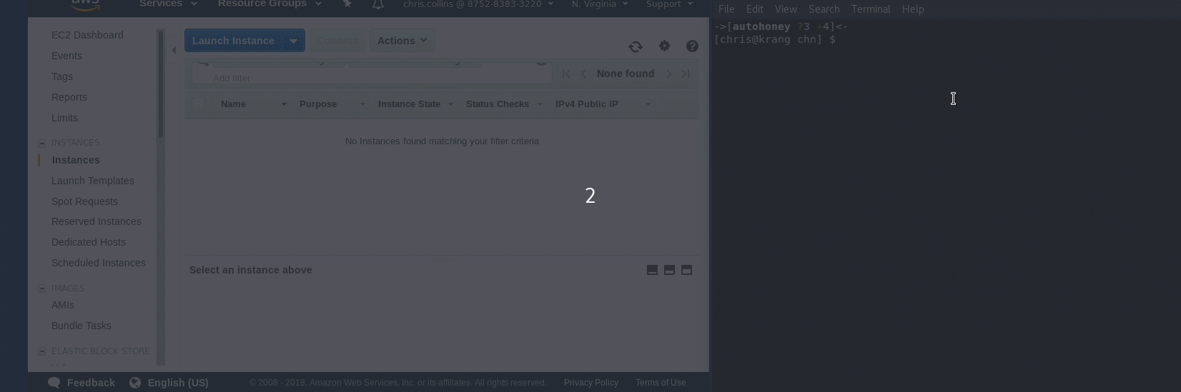

Slide 14
Building a Honeypot
DEBUG=false
CHN_SERVER="http://chnserver"
FEEDS_SERVER="localhost"
FEEDS_SERVER_PORT=10000
DEPLOY_KEY=<key>
SSH_LISTEN_PORT=2222
TELNET_LISTEN_PORT=2223
version: '2'
services:
cowrie:
build:
context: https://github.com/CommunityHoneyNetwork/cowrie.git#v1.2
dockerfile: Dockerfile-centos
image: cowrie:centos
volumes:
- ./cowrie.sysconfig:/etc/sysconfig/cowrie
- ./cowrie:/etc/cowrie
ports:
- “2222:2222”

Slide 15
Honeypots Ready to Deploy
Cowrie
  SSH / Telnet honeypot
  Logs brute force attacks + shell sessions
Dionaea
  Multi-service honeypot
  Captures binaries, auto uploading to VirusTotal and Sandbox services
  FTP, HTTP, MySQL, MSSQL, SMB, SIP, TFTP, etc

Slide 16
Honeypots ready for alpha testers
Wordpot – Wordpress website honeypot
Conpot – SCADA device honeypot
Glastopf – Generic web honeypot
RDPHoney – Simple RDP honeypot
Amun – Low-interaction multi-service honeypot

Slide 17
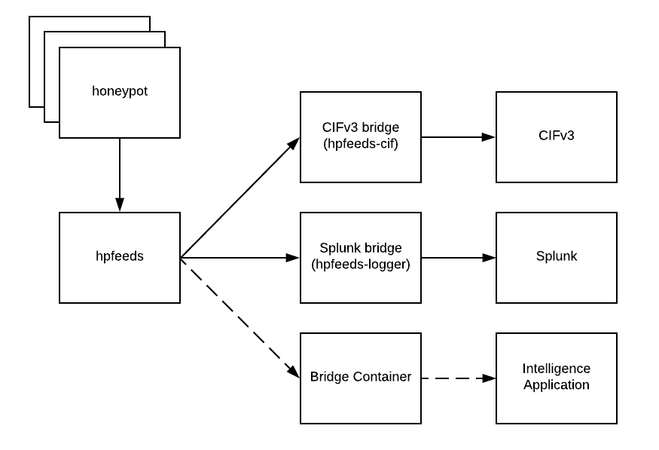
Integrating CHN with Other Applications

Slide 18
sysconfig
docker-compose.yml
HPFEEDS_HOST='hpfeeds'
HPFEEDS_PORT=10000
MONGODB_HOST='mongodb'
MONGODB_PORT=27017
CIF_HOST='http://cifv3:5000'
CIF_TOKEN=''
CIF_PROVIDER='chn'
version: '2'
services:
hpfeeds-cif:
build:
context: https://github.com/CommunityHoneyNetwork/hpfeeds-cif.git
dockerfile: Dockerfile-centos
image: hpfeeds-cif:centos
volumes:
- ./hpfeeds-cif.sysconfig:/etc/sysconfig/hpfeeds-cif:z

Slide 19
CIFv3 in Docker
https://github.com/CommunityHoneyNetwork/stingar-cif
version: '2'
services:
stingar-cif:
build:
dockerfile: ./Dockerfile-centos
context: https:// github.com/CommunityHoneyNetwork/stingar-cif
image: stingar-cif:centos
privileged: true
links:
- hpfeeds:hpfeeds
ports:
- localhost:5000:5000

Slide 20
Getting data out of CIFv3
CIFv3 API
  $ curl -v -H "Authorization: Token token=1234" -i https://cif-server:5000/indicators?indicators
CIFv3 Python SDK
  cif --token 1234 --remote 'https://localhost' -q example.com

Slide 21
CHN data in CIFv3
{
"itype":"ipv4",
"indicator":"10.182.1.56",
"reporttime":"2018-04-05T17:13:09.014466Z",
"provider":"chn",
"tags":[
"honeypot"
],
"portlist":"None",
"confidence":8.0,
"lasttime":"2018-04-05T17:13:09.014431Z",
"count":1,
"tlp":"amber",
"firsttime":"2018-04-05T17:13:09.014431Z",
"additional_data":null
}

Slide 22
Using Threat Intelligence from CHN
Splunk
Black Hole Routing
Host based / network firewall rules

Slide 23
Future Plans

Slide 24
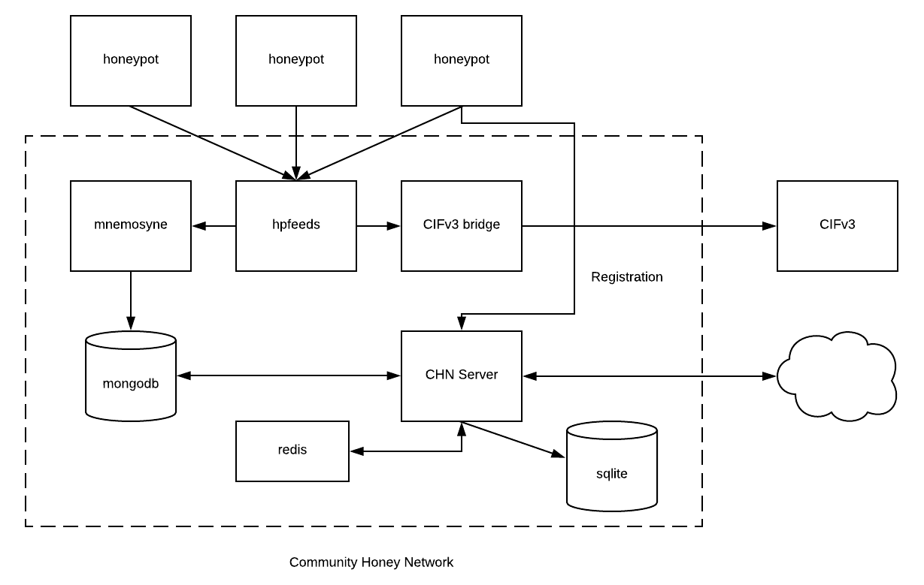

Slide 25
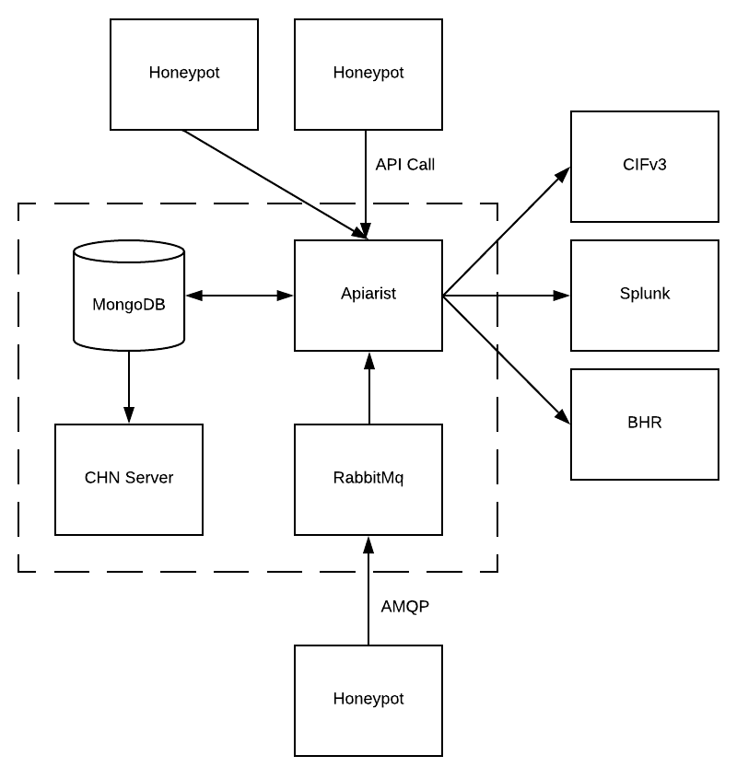

Slide 26
How You Can Help

Slide 27
Documentation:
  Communityhoneynetwork.github.io
Repository:
  https://github.com/CommunityHoneyNetwork
Contact:
  stingar@duke.edu
  Twitter:
    @ChrisInDurham
    @merckedsec

Slide 28
QUESTIONS?

