Slide 1
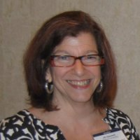
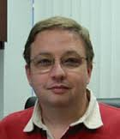
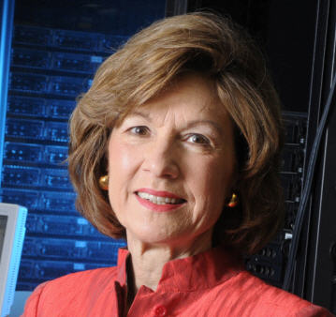
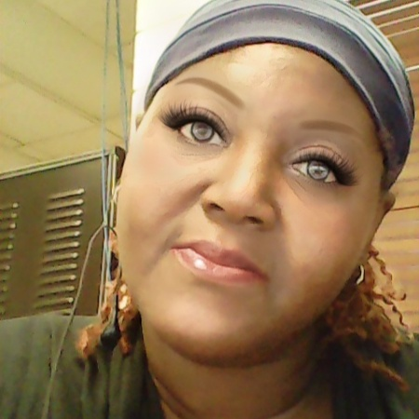
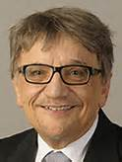
CICI Regional: SouthEast SciEntific Cybersecurity for University Research (SouthEast SECURE)
Clemson University: Jill Gemmill
University of Tennessee-Chattanooga: Tony Skjellum
University of Alabama at Huntsville: Sara Graves
Voorhees College: Veronical Gadsden
Jackson State University: Richard Alo

Slide 2
The Program
Survey NSF funded investigators in the SouthEast
Provide Cybersecurity Metrics
Student-built devices
University web site SSL/TLS security & patch speed over time
Facilitate communication between research faculty and university IT/Data Security staff.
Provide practical assistance
On-campus or individual training
Downsize great CTSC materials
Create engaging content for domain scientists

Slide 3
Some features of the SouthEast
New NSF awards in FY14. A total of 579 institutions received funding that year; of these, 47 were HBCUs, 5 were Minority Serving Institutions, and 8 were Hispanic minority serving institutions.

Slide 4
What help with cybersecurity do NSF-PIs need? - SURVEY (anonymous)
707 Responses
10-18% response rate

Slide 5
Who Answered Survey?

Slide 6
Who Answered Survey?

Slide 7
What kind of information technology (IT) systems does your NSF project use (computers, servers, network connected instrumentation, etc.)? Check all.

Slide 8
Which of the following "cloud" services is your project using? Check all that apply.

Slide 9
Who maintains your IT systems to keep them in working order? Check all that apply.

Slide 10
Where do your NSF project cyber security requirements come from? Check all that apply.

Slide 11
Do you (or your team) create your own websites or write your own software/software modules?

Slide 12
How does cyber security impact your current NSF projects? Select the response that most closely matches your opinion.
“not sure”; “haven’t thought about it”

Slide 13
What kinds of cyber attacks have impacted your NSF project? Check all that apply.

Slide 14
Please contact me at the email address above about:

Slide 15
Does your cybersecurity training look like this?

Slide 16
What is CyberSecurity?
Cybersecurity is the protection of data and computer systems from illicit access or acquisition of equipment, software, and / or data.

Slide 17
Important Facts
91% of cyberattacks start with email
Ransomware: software that can encrypt and lock your assess to that data
Insider threats are a major concern
Intellectual Property (IP) theft can be expensive and can affect your professional career
NSF is concerned about cybersecurity and privacy protection

Slide 18
What might be more effective

Slide 19
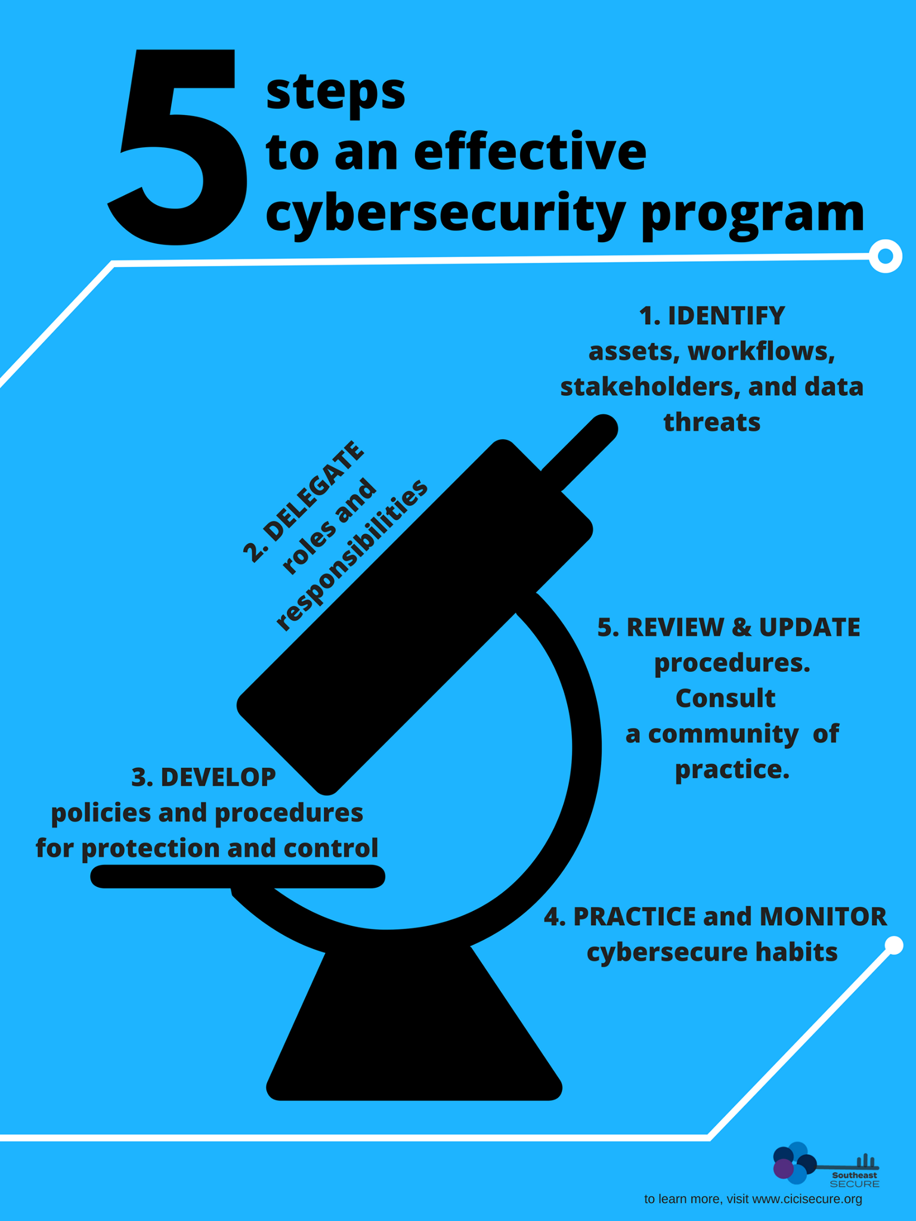

Slide 21
Collaborative Research: CICI: Regional: SouthEast SciEntific Cybersecurity for University Research (SouthEast SECURE) - Jill Gemmill (PI) This material is based upon work supported by the National Science Foundation under Grants No. 1642102; 1642083; 1642069; and 1642038. Any opinions, findings, and conclusions or recommendations expressed in this material are those of the author(s) and do not necessarily reflect the views of the National Science Foundation.

Slide 22
Questions & Discussion
Contact Jill Gemmill
jbg@clemson.edu

