Slide 1


WebStor: Agile Identification of Vulnerable Webservers
Ross Geerlings
Product Manager - Pen Testing, Vulnerability Mgt, Sensitive Data Discovery
University of Michigan – Ann Arbor
rjgeer@umich.edu
Notes:
WS and how it can help us find vulnerable web technologies.

Slide 2
Agenda
The Problem Organizations Have When Zero-Days Drop
Challenges to Solving the Problem
How WebStor Finds Vulnerable Sites Quickly
Demonstration of WebStor
Summary and Questions

Slide 3

The Problem
When a zero-day exploit is released, finding your exposure can be very time-consuming.
Notes:
Seems to be especially true at universities. Lots of ‘stuff’
Things constantly changing
Probably usually less central authority.
-
There are factors that go into how time consuming this can be (but we’ll save for later), but the size of nets and complexity of organizational structure are factors.
Several factors in place that make this a tough problem to resolve.

Slide 4
The Part of the Problem We’re Solving
WebStor was designed to solve this problem specifically for web technologies.
Big subset of the problem
Tractable
Notes:
This may already be clear but I need to say that from this point forward when I refer to zero-days I’m talking in the scope of web technhologies.

Slide 5

Problem Multiplier:
Decentralized Administration
Some organizations and most universities have decentralized administration. For example, U-M has 19 schools and colleges. It would be a big challenge for central IT to know where every instance of a particular web technology is. Change is constant.
Notes:
U-M Examples

Slide 6
Problem Multiplier:
Decentralized Organizations (Cont.)
Changing the administrative structure of the organization is not possible for most IT groups.
We need to work around this problem from a technical angle.
Notes:
We should note this here, in case it’s not clear, that you’re not going to work around this by advocating for some change in the way IT is governed. At least not in my experience.

Slide 7
VM and Inventory Solutions Don’t Solve the Problem
Even inventory and vulnerability management solutions miss things.
  Precise version information
  Specific configurations
  All but the most common web technologies
That’s why we always end up port scanning and for an up-to-date picture of where web servers are and then…
Notes:
Discovery solutions rely on installation footprint or a lot of care and feeding. And even in the best of cases you’re never going to get something that’s complete.
Bottom line is they may help a little but they don’t fix the problem.

Slide 8

The Problem
Once we’ve mapped out where we have open HTTP/HTTPS ports, we have a choice between two other options that take time:
Write or run a custom script to find this particular vulnerability
Wait for your vulnerability management solution to have a plugin, and run a scan
Notes:
Every time, this seems to be where we were stuck.
Remember that the port scanning can take time by itself, and now you have this on top of it.
If you’re lucky, you can scrutinize some script that’s already done. It’s going to run serially.

Slide 9
The Problem:
Where All of This Leaves Us
We’re left with a process that can take a long time, potentially many hours, and that can be too long.
Port Scanning
Writing or using a new script, or waiting for our VM solution to have a plugin to scan what we mapped.
As we’ll see later, this process is also flawed in that it potentially misses a lot of your exposure.
Notes:
This can take virtually all of a work day. We’re port scanning, we’re writing a script, using someone else’s (serial process), or we’re running a plugin which, which most convenient, usually takes the longest.
And a big thing we’re going to see, later, is this process still misses a lot on top of taking forever.

Slide 10

Notes:
Hopefully you’d think that’s great.
Altruistic
Even if you don’t care about the compromise of helping your IR/SOC team, you can be driven by the desire to not do a bunch tedious work anymore. This is why things get automated!
This is a solution for everyone

Slide 11
Solving the Problem:
Basic Elements
We know that our challenges are:
There are usually administrative and structural challenges.
It’s hard to find a reasonable approximation of everything out there, especially for a large organization, quickly.
WebStor confronts these challenges through technical means via:
Speed Multipliers
Expanding our field of vision
Caching
Notes:
You could even say it’s difficult to find a reasonable approximation, period.
The regularity of the caching is up to you, but you want fresh results.

Slide 12
What We Need to Have
We need to check responses of all websites on all hosts on common HTTP/HTTPS ports and look for a string/regex telling us if they’re vulnerable.
  Almost all those custom scripts are looking for that.
  Side note: This may also be useful at times to find already-compromised hosts.
We want on-demand checks done in seconds instead of hours.
Notes:
Second instead of hours is what makes the difference between being compromised and not being compromised.

Slide 13
Technical Challenges
Multiple host headers/virtual hosts on a single webserver.
Things outside on-premises networks, e.g. public cloud… can’t go by net range.
It takes time to port scan a large address space.
It takes time to get responses for a large number of websites.

Slide 14
Technical Challenge: Multiple Sites with Multiple Names on a Webserver
A webserver can have many named websites on one single IP address so this is VERY important given that we need to assess all websites!
To have an idea of which sites are served from which IPs, we’re going to use the data from DNS.
Notes:
We could have 6, or dozens of sites on a single-IP host dedicated to web hosting. And a lot of times, maybe even the most likely outcome, you might hit that IP and get the least interesting or useful thing of all, a default site.

Slide 15
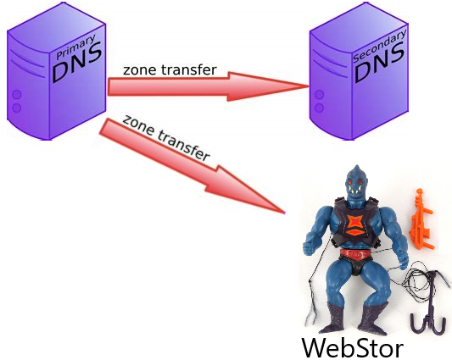
Technical Challenge: Multiple Sites with Multiple Names on a Webserver
Normally DNS zone transfers are used to replicate DNS records across DNS servers.
WebStor uses them to know which hostnames correspond to the IPs with open web ports.
Notes:
We’re using zone transfers in a non-standard way here. But it’s very informative, and well-purposed for what we’re doing. There’s probably not a way to do this better.
It’s surprising no one’s used them this way before.

Slide 16
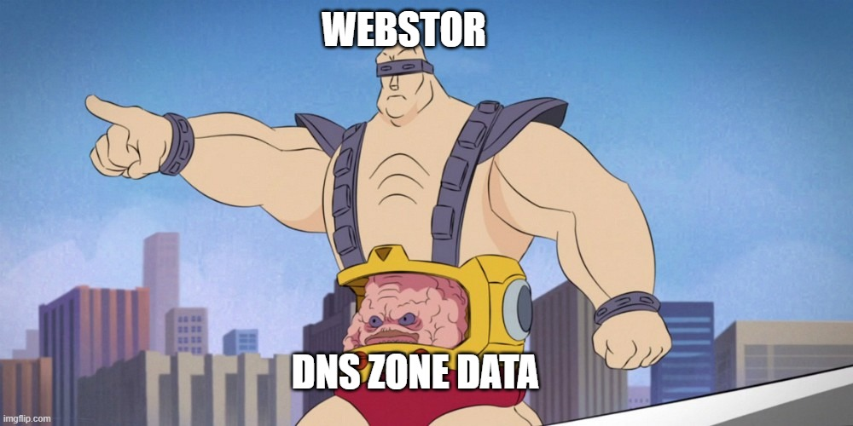
DNS zone transfer data is central to blue-team use of WebStor.
If your organization uses DNSSec, you’ll need a TSIG Key.
WebStor could still be somewhat useful for things like bug bounties without it but that’s out of this scope of this presentation.
Notes:
For our use and what we’ll be talking about today, blue team use is all that matters.
Talk about options for TSIG keys. You can keep one or more of these in the WebStor database. Talk about file spec as well.
But to a smaller degree, this could be a convenient tool to help out with bug bounty hunters. I may talk about that later on.

Slide 17

Additional Benefits of Using DNS
We give WebStor our campus net ranges up front.
DNS records show WebStor which names in our zones (e.g. *.umich.edu) map to addresses outside our campus IP ranges. It adds the these name/IP combos to what we are inspecting so that any webserver we host in the cloud is covered.

Slide 18
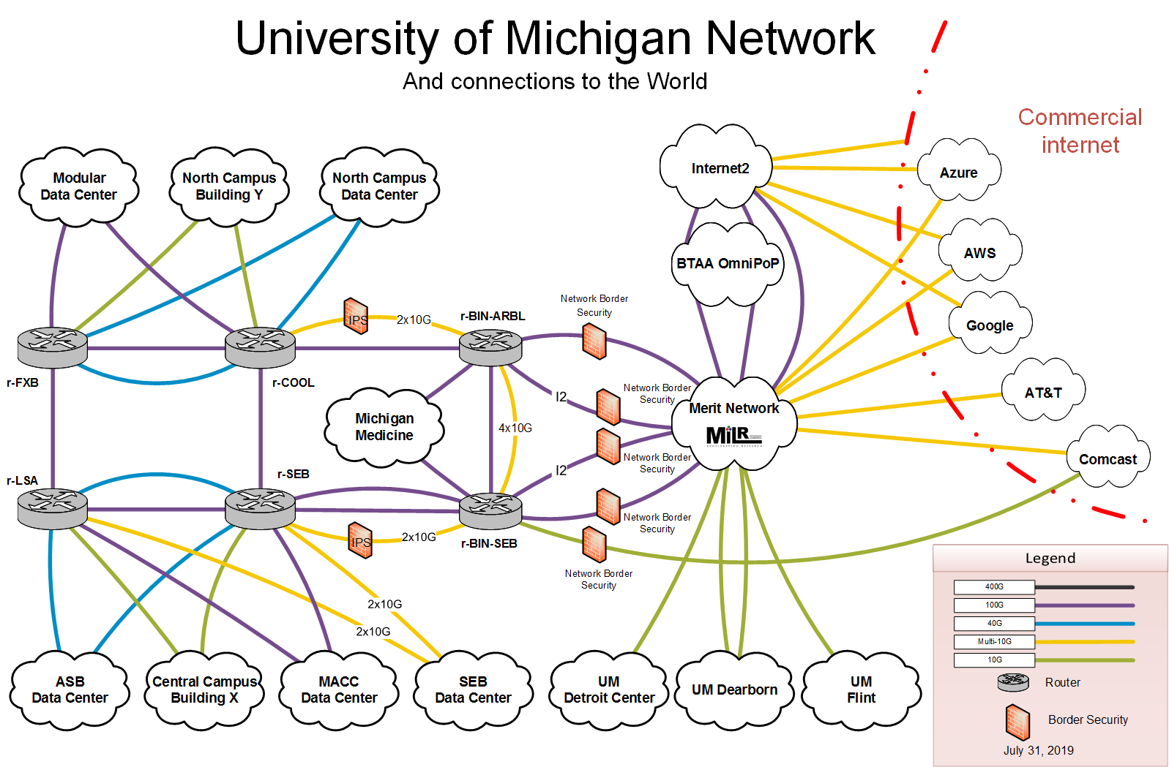
Technical Challenge: Many Addresses to Scan
U-M networks: 1.7 million IP addresses with tens of thousands of websites. This can make searching for webservers take a long time.

Slide 19
Technical Challenge: Many Addresses to Scan (Cont.)
Before we can analyze what web technologies are powering websites on our network, we have to figure out where all the websites are.
Tools like Masscan and Zmap can find common open web ports, even across our 1.7 million IP address space, quickly (in minutes).
  WebStor uses Masscan because of its ability to check multiple ports in one scan.

Slide 20
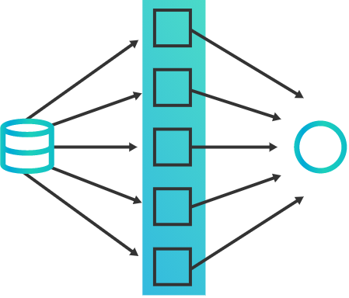
Technical Challenge: Many Requests to Send and Responses to Store
Sending many HTTP requests in parallel quickly completes 50,000 requests within minutes.
They’re stored in a MariaDB database, which allows us to do regex-based queries.

Slide 21
Easy Lookups
Sometimes we might just want to know where some common web technology is.
  In these cases, it’d be nice not to have to research regexes in responses.
Using Wappalyzer technologies database allows searches for many common technologies by name, so we don’t even have to know a string in the HTTP response.

Slide 22
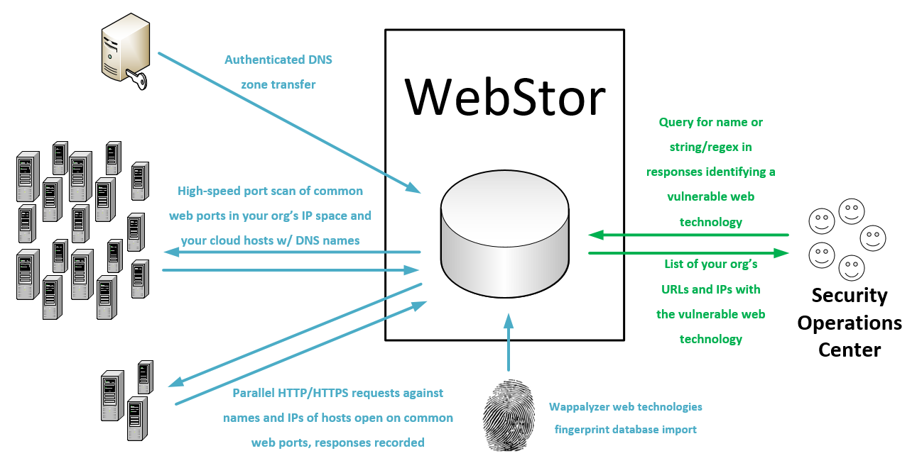
What Does All That Look Like Together?

Slide 23
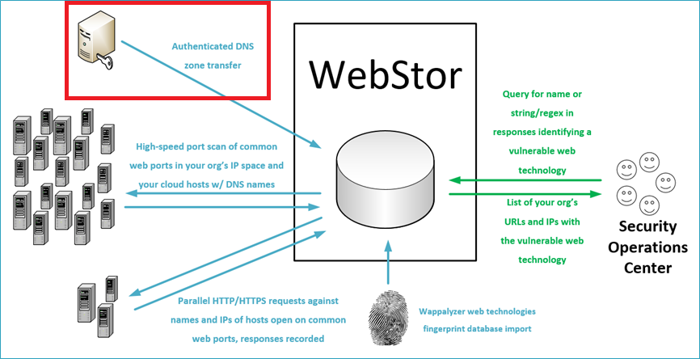
What Does All That Look Like Together?

Slide 24


Slide 25


Slide 26
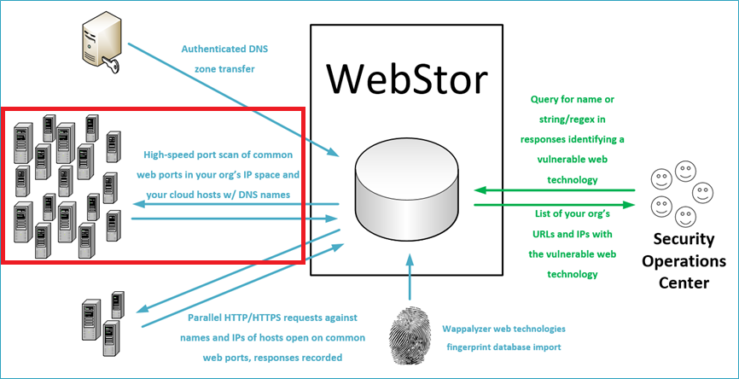
What Does All That Look Like Together?

Slide 27
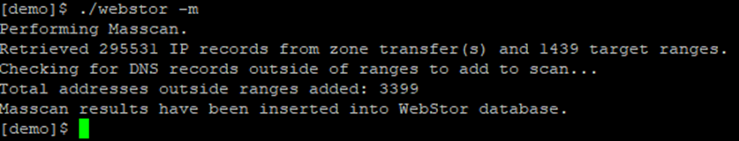

Slide 28
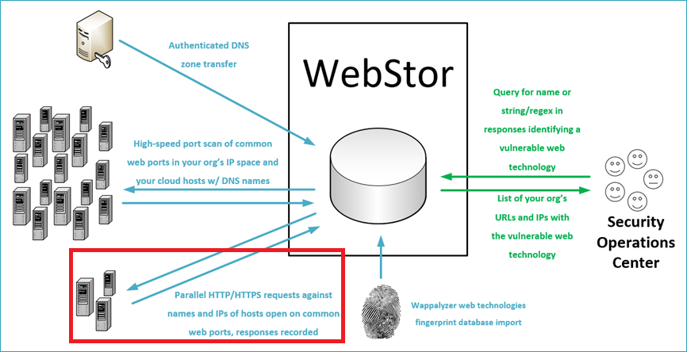
What Does All That Look Like Together?

Slide 29

…

Slide 30
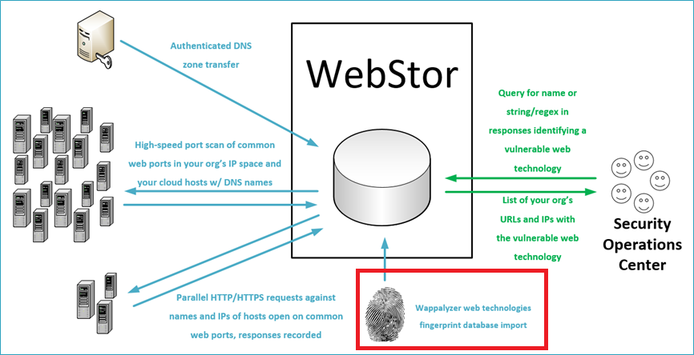
What Does All That Look Like Together?

Slide 31


Slide 32

Using WebStor:
Custom Pattern Example
First, we look at the WebStor config. We’ve added a named custom pattern to find a few specific old versions of WordPress.
Then we query for that pattern. All matching sites are returned in 3.58 seconds.

Slide 33
Typical Usage
Each morning, cron job: webstor –z –m –r –w
  Updates DNS data
  Does a new masscan
  Performs requests based on prior steps and stores results to the database
  Updates the wappalyzer database.

Slide 34
Responses from Specific Paths
We’ve already seen a custom parttern lookup, which is the most common use case, but what if we need to be checking a specific non-root path?
  If we’ll always want to check it from now on:
  webstor –r –p /the/new/path
  If it’s a one-time check:
  webstor –rP /the/new/oneTimePath

Slide 35
External IPs/Names
One feature of WebStor, its ability to get addresses outside your defined internal ranges, might be generally useful for other purposes.
To dump a list of IP/name combinations external to your network ranges found by WebStor, you can use: webstor –e
Notes:
For the moment, this gets everything outside the ranges you defined. In the future, I’ll probably put an option to disregard all RFC1918.

Slide 36
WebStor is Free and Open-Source
WebStor is available for download on GitHub.
  Check it out at https://github.com/RossGeerlings/webstor
It’s licensed under terms of the MIT license, which essentially allows anyone to use it for any purpose.
It’s also deployed to PyPI, which allows for easier installations and simpler use.

Slide 37
WebStor: How it Changes Things
Faster Identification
  Up until now, when a zero-day web vulnerability appeared, IR/ SOC would ask the VM team to find all instances of it and an hours-long process would begin.
  Now they execute a query in a few seconds.
More complete results
  With hostnames, all websites hosted by a server will be returned rather than just the one responding to a request against the IP address. This adds hundreds of websites that wouldn’t have been checked before.
  Cloud websites with DNS records are now included.
This dramatic reduction in time and improved visibility will almost certainly prevent future server compromises.

Slide 38
Questions?

